Slide 1


Veteran & New
Farmer Program
Composting
To produce an organic, slow release fertilizer and soil amendment
Mark Acosta, Peggy Denney, Ilene Quitugua, Frank Cruz, and Bob Barber
University of Guam Cooperative Extension Service
Support from:

Slide 2
Introduction to Composting
What is composting?
  Composting is a natural process which breaks down organic material derived from animals and plants into an organic fertilizer and soil amendment
  This “Breakdown” is an aerobic (requires oxygen) process, by which bacteria, fungi, and other microorganisms decompose organic material

Slide 3
Reasons for Composting
A method of waste management
  Recycles organic material
  Reduces volume of waste/landfill issues
  Speeds up the breakdown of plant and animal residues
  Minimizes/eliminates pollution from plant and animal wastes
  Eliminates odors from animal waste
Production of organic fertilizer and soil amendment
  Use of compost as a soil amendment improves soil quality
    Increases agricultural productivity
  Compost binds nutrients and releases them slowly
  Use of compost helps build the soil and conserve water

Slide 4
Disadvantages
Composting is a process that requires management and resources. Improper management can result in:
  Point source pollution
  Odor production
  Diseases from animal manures may survive in the compost
  Weed seeds may survive in the compost
Composting requires time/labor

Slide 5
What Can Be Composted?
Yard debris
  leaves, grass clippings, tree branches
Household waste
  Vegetable and fruit peelings, coffee grounds and filters, crushed eggshells, tea bags, dryer lint
  cardboard, shredded paper, etc.
Animal manure

Slide 6
Materials Not Recommended for Backyard Composting
Meat/bones
Fatty foods
Pet litter/manure
Human manure
Dead animals (requires very large compost piles)

Slide 7
Requirements for Composting
A basic understanding of the compost process can help produce a high quality product, while preventing many common problems
The microorganisms that do the work in composting have a few basic requirements which need to be provided
Air, water, carbon, nitrogen and the ideal temperature combine to create a good composting environment

Slide 8
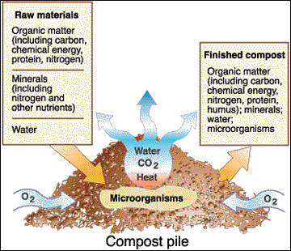
Requirements for Composting
Water
Oxygen
Temperature
Time
Microorganisms
Carbon (browns)
Nitrogen (greens)
Picture From MU Guide

Slide 9
Water Requirements
Microorganisms need water to perform their function. Ideally, the moisture content should be between 40 and 60 percent.
  Too much moisture results in anaerobic conditions and the production of foul odor
  Moisture content below 40 percent slows down the decomposition process
  Should be moist but not dripping (need to squeeze to get water)
Microorganisms need oxygen for growth and development
  Aerobic (oxygen present) conditions speed up the process of decay and prevent odor problems

Slide 10
Conditions That Promote Composting
Temperature:
  Ideal temperature range is between 90°F-160°F
  Weed seeds and plant pathogens are destroyed within the range of 135 - 160°F
  0 °F - 70 °F - psychrophilic bacteria thrive
  40 - 110 °F - mesophilic bacteria thrive
  100 - 200 °F - thermophilic bacteria thrive
Time:
  In the tropics, small or fine particles can be thoroughly composted in one to three months.

Slide 11
Conditions that Promote Composting
Surface Area:
  High material surface area (small particle size) promotes faster decomposition by microorganisms
  Increase surface area by tearing, shredding, or chopping the materials to be composted

Slide 12
Carbon and Nitrogen Ratio
Bacteria, fungi, and other microorganisms get their energy from carbon sources, such as leaves, brush, or wood chips.
Nitrogen is a nutrient required for growth by microorganisms, but excess nitrogen can generate ammonia and other odors and can pollute runoff water. If high nitrogen materials such as grass clippings are used, they must be thoroughly mixed with a high carbon source.

Slide 13
Components of the Compost Mix
Browns - primary carbon source:
  Are the main food and energy source for microorganisms
  Coarse browns provide air spaces in the compost pile
  Act like a drying agent
  Types of materials rich in carbon:
    Woodchips/branches
    Brown leaves
    Shredded paper
    Shredded cardboard

Slide 14
Components of the Compost Mix
Greens - nitrogen source:
  Nutrient source for microorganisms
    Required for reproduction and growth
  Materials Rich in Nitrogen:
    Animal manure
    Green vegetation
      Grass clippings
    Kitchen waste
  Water - ideal moisture content is between 40% and 60%

Slide 15
Brown to Green Ratio
Recommended Brown: Green ratio
  3 parts brown for every 1 part green
Too much carbon (browns) results in slow decomposition process
Too much nitrogen (greens) can be lost as ammonia (odor) or by leaching

Slide 16
Building the Compost Pile
Thoroughly mix three parts browns with one part greens
Add water to get about 50% moisture in the mix
  The mix should feel moist but not wet enough to squeeze out water from the mixture
Make a pile at least one cubic yard (3’x3’x3’) in size to accelerate heat production and maximize heat retention
Cover the pile or protect it from drying out or becoming too wet

Slide 17
Managing the Compost Pile
Add water as needed to maintain 40% to 60% moisture content
  Keep moist but not saturated
  If conditions are too wet, anaerobic microorganisms (those that can live without oxygen) take over the composting process resulting in foul odor
Turn the pile every 3 to 4 days. After turning you want the temperature to rise above 160º F. You turn again when the temperature begins to drop.
  Turning the pile replenishes the oxygen supply and ensures that all the material is evenly composted

Slide 18
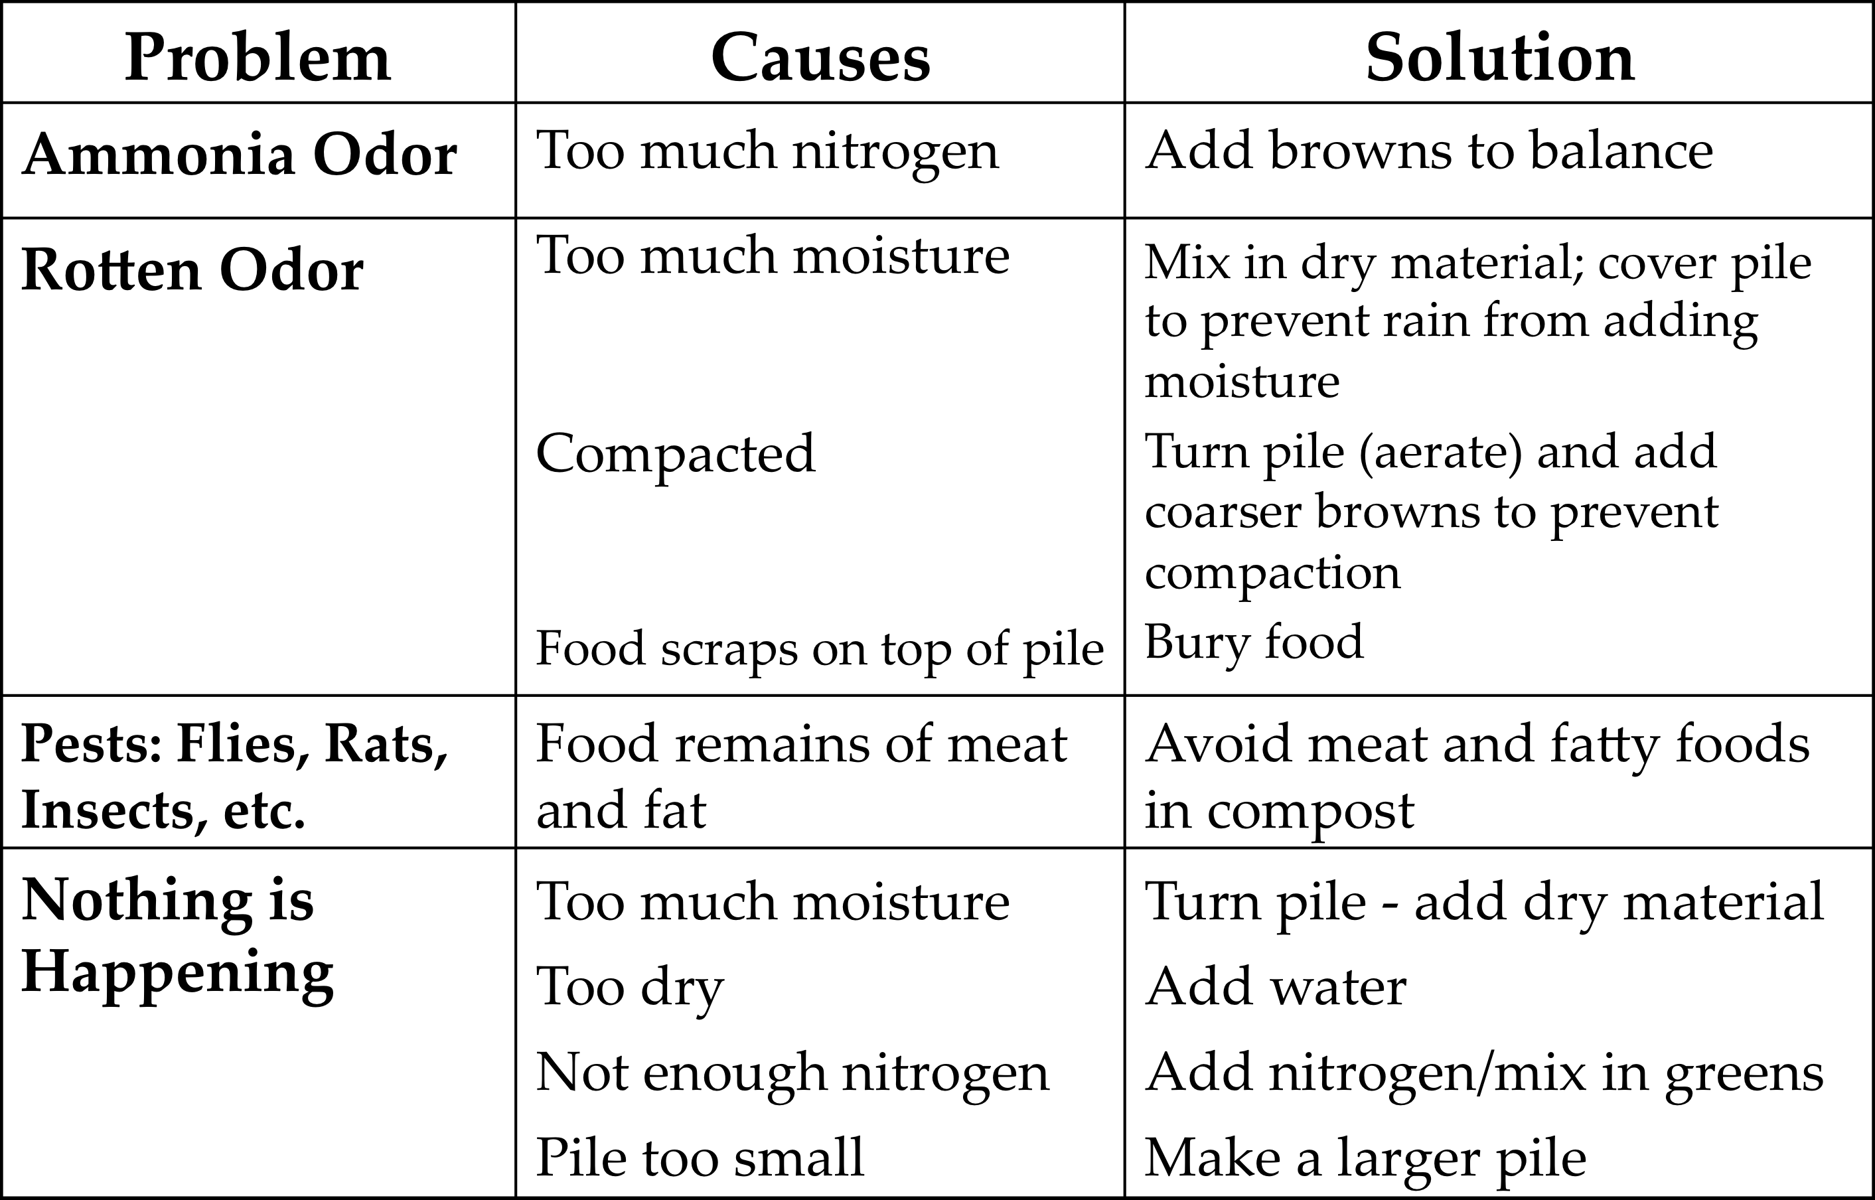
Common Problems

Slide 19
Composting Methods
Fast or active composting:
  Labor intensive
  Compost must be turned every 3 – 5 days
  Compost produced in two months or less
  Three-bin method is recommended
Passive or slow composting:
  Low labor and longer time
  Six months – couple of years
  Large unturned piles

Slide 20
Compost Bins
Compost bins can be constructed in many different ways using a variety of materials.
Bins should be well suited for the needs and ability of the consumer
Bins should be designed to facilitate turning

Slide 21
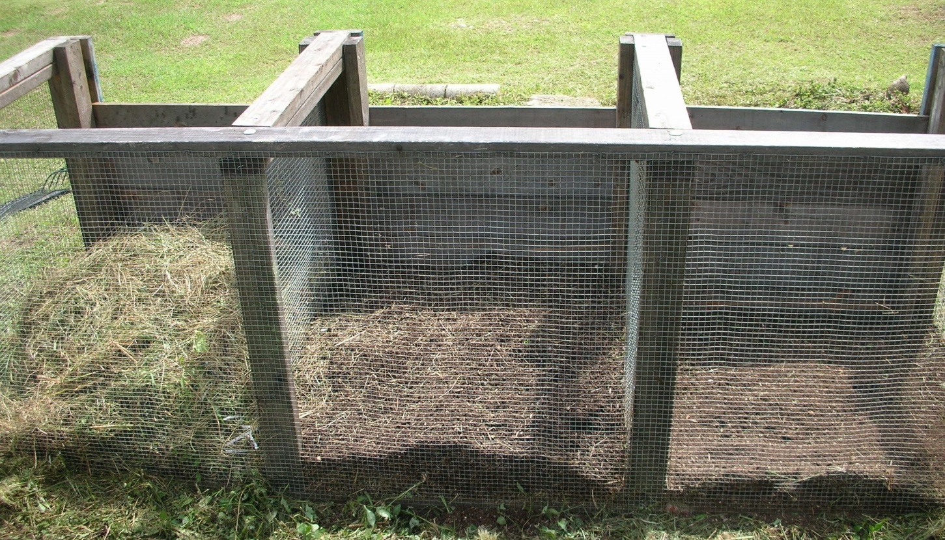
Three Bin

Slide 22
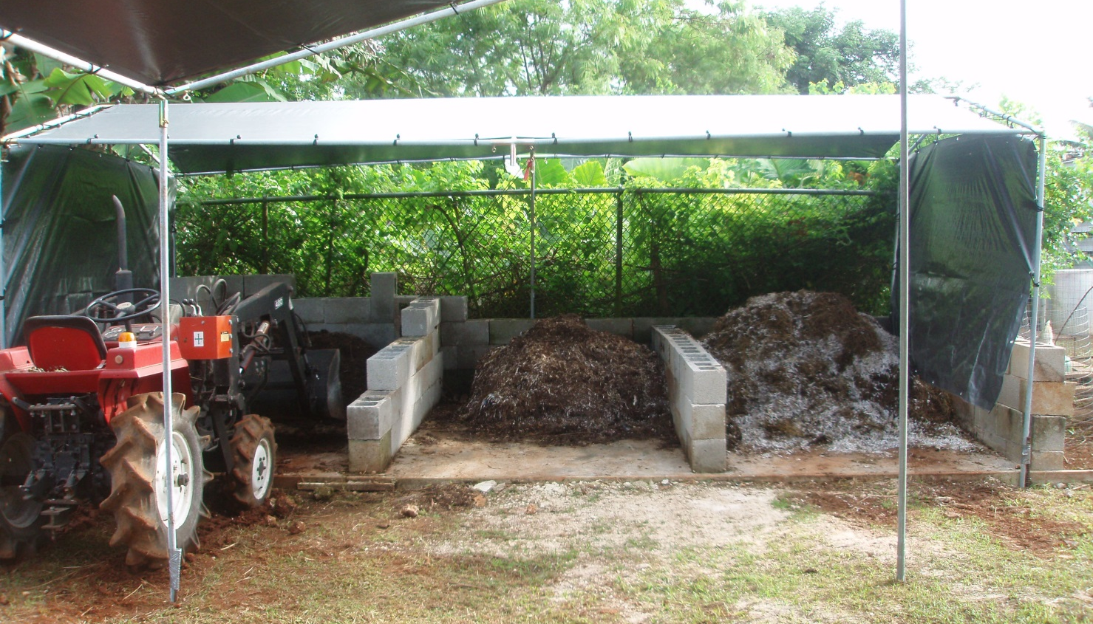
Three Bin for Hog Waste System

Slide 23
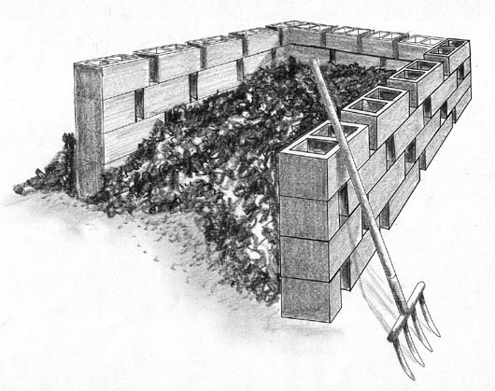
Concrete Block Bins

Slide 24
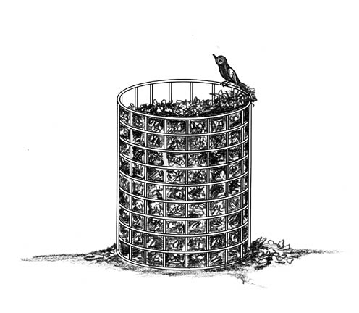
Wire Bins

Slide 25
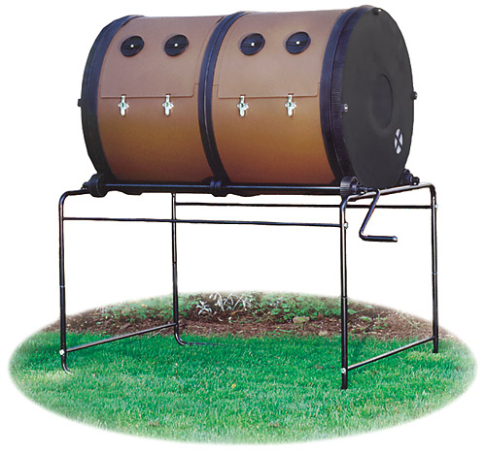
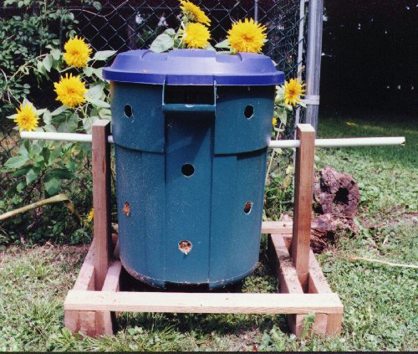
Purchased Composting Systems

Slide 26
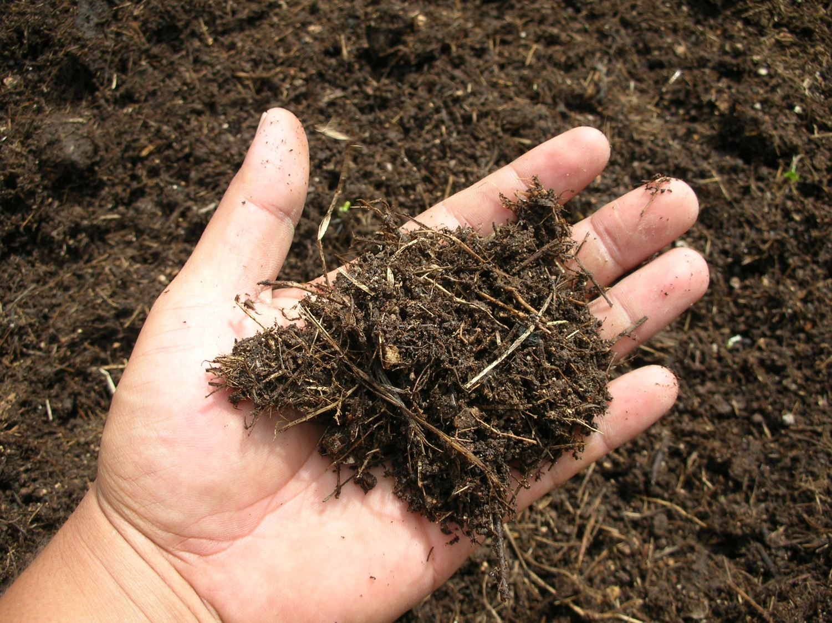
Have fun composting!

